Slide 1

PlateShare 🍛

Slide 2
Project Description
Our project, "PlateShare," is a culmination of our Web Design Final Project, aimed at addressing the critical issue of food scarcity through the lens of community collaboration. In the contemporary landscape, food scarcity stands as a formidable global challenge. "PlateShare" serves as a pioneering web platform designed to foster Nourishing Networks: Building Bridges for Food Security.
Our innovative solution facilitates the connection between organizations committed to alleviating food insecurity and individuals eager to contribute to this cause. Through "PlateShare," organizations planning food donation drives, distributions, and social services can seamlessly connect with volunteers from the community who are willing to register and lend their support.
"PlateShare" offers a range of flexible volunteering opportunities, enabling individuals to donate their time, skills, and resources. Whether it's sparing a couple of hours from a busy work schedule to assist an NGO in setting up a basic website, leveraging management skills to organize donation camps, or contributing financial donations, our platform provides avenues for diverse forms of support. Together, we aim to forge a collaborative ecosystem where every contribution, no matter how small, makes a significant impact in the fight against food scarcity.

Slide 3
Team Members
Akanksha Pandey (pandey.akan@northeastern.edu)
Akanksha Pawar (pawar.ak@northeastern.edu)
Chetan Warad (warad.c@northeastern.edu)
Yash Deshpande (Deshpande.ya@northeastern.edu)

Slide 4
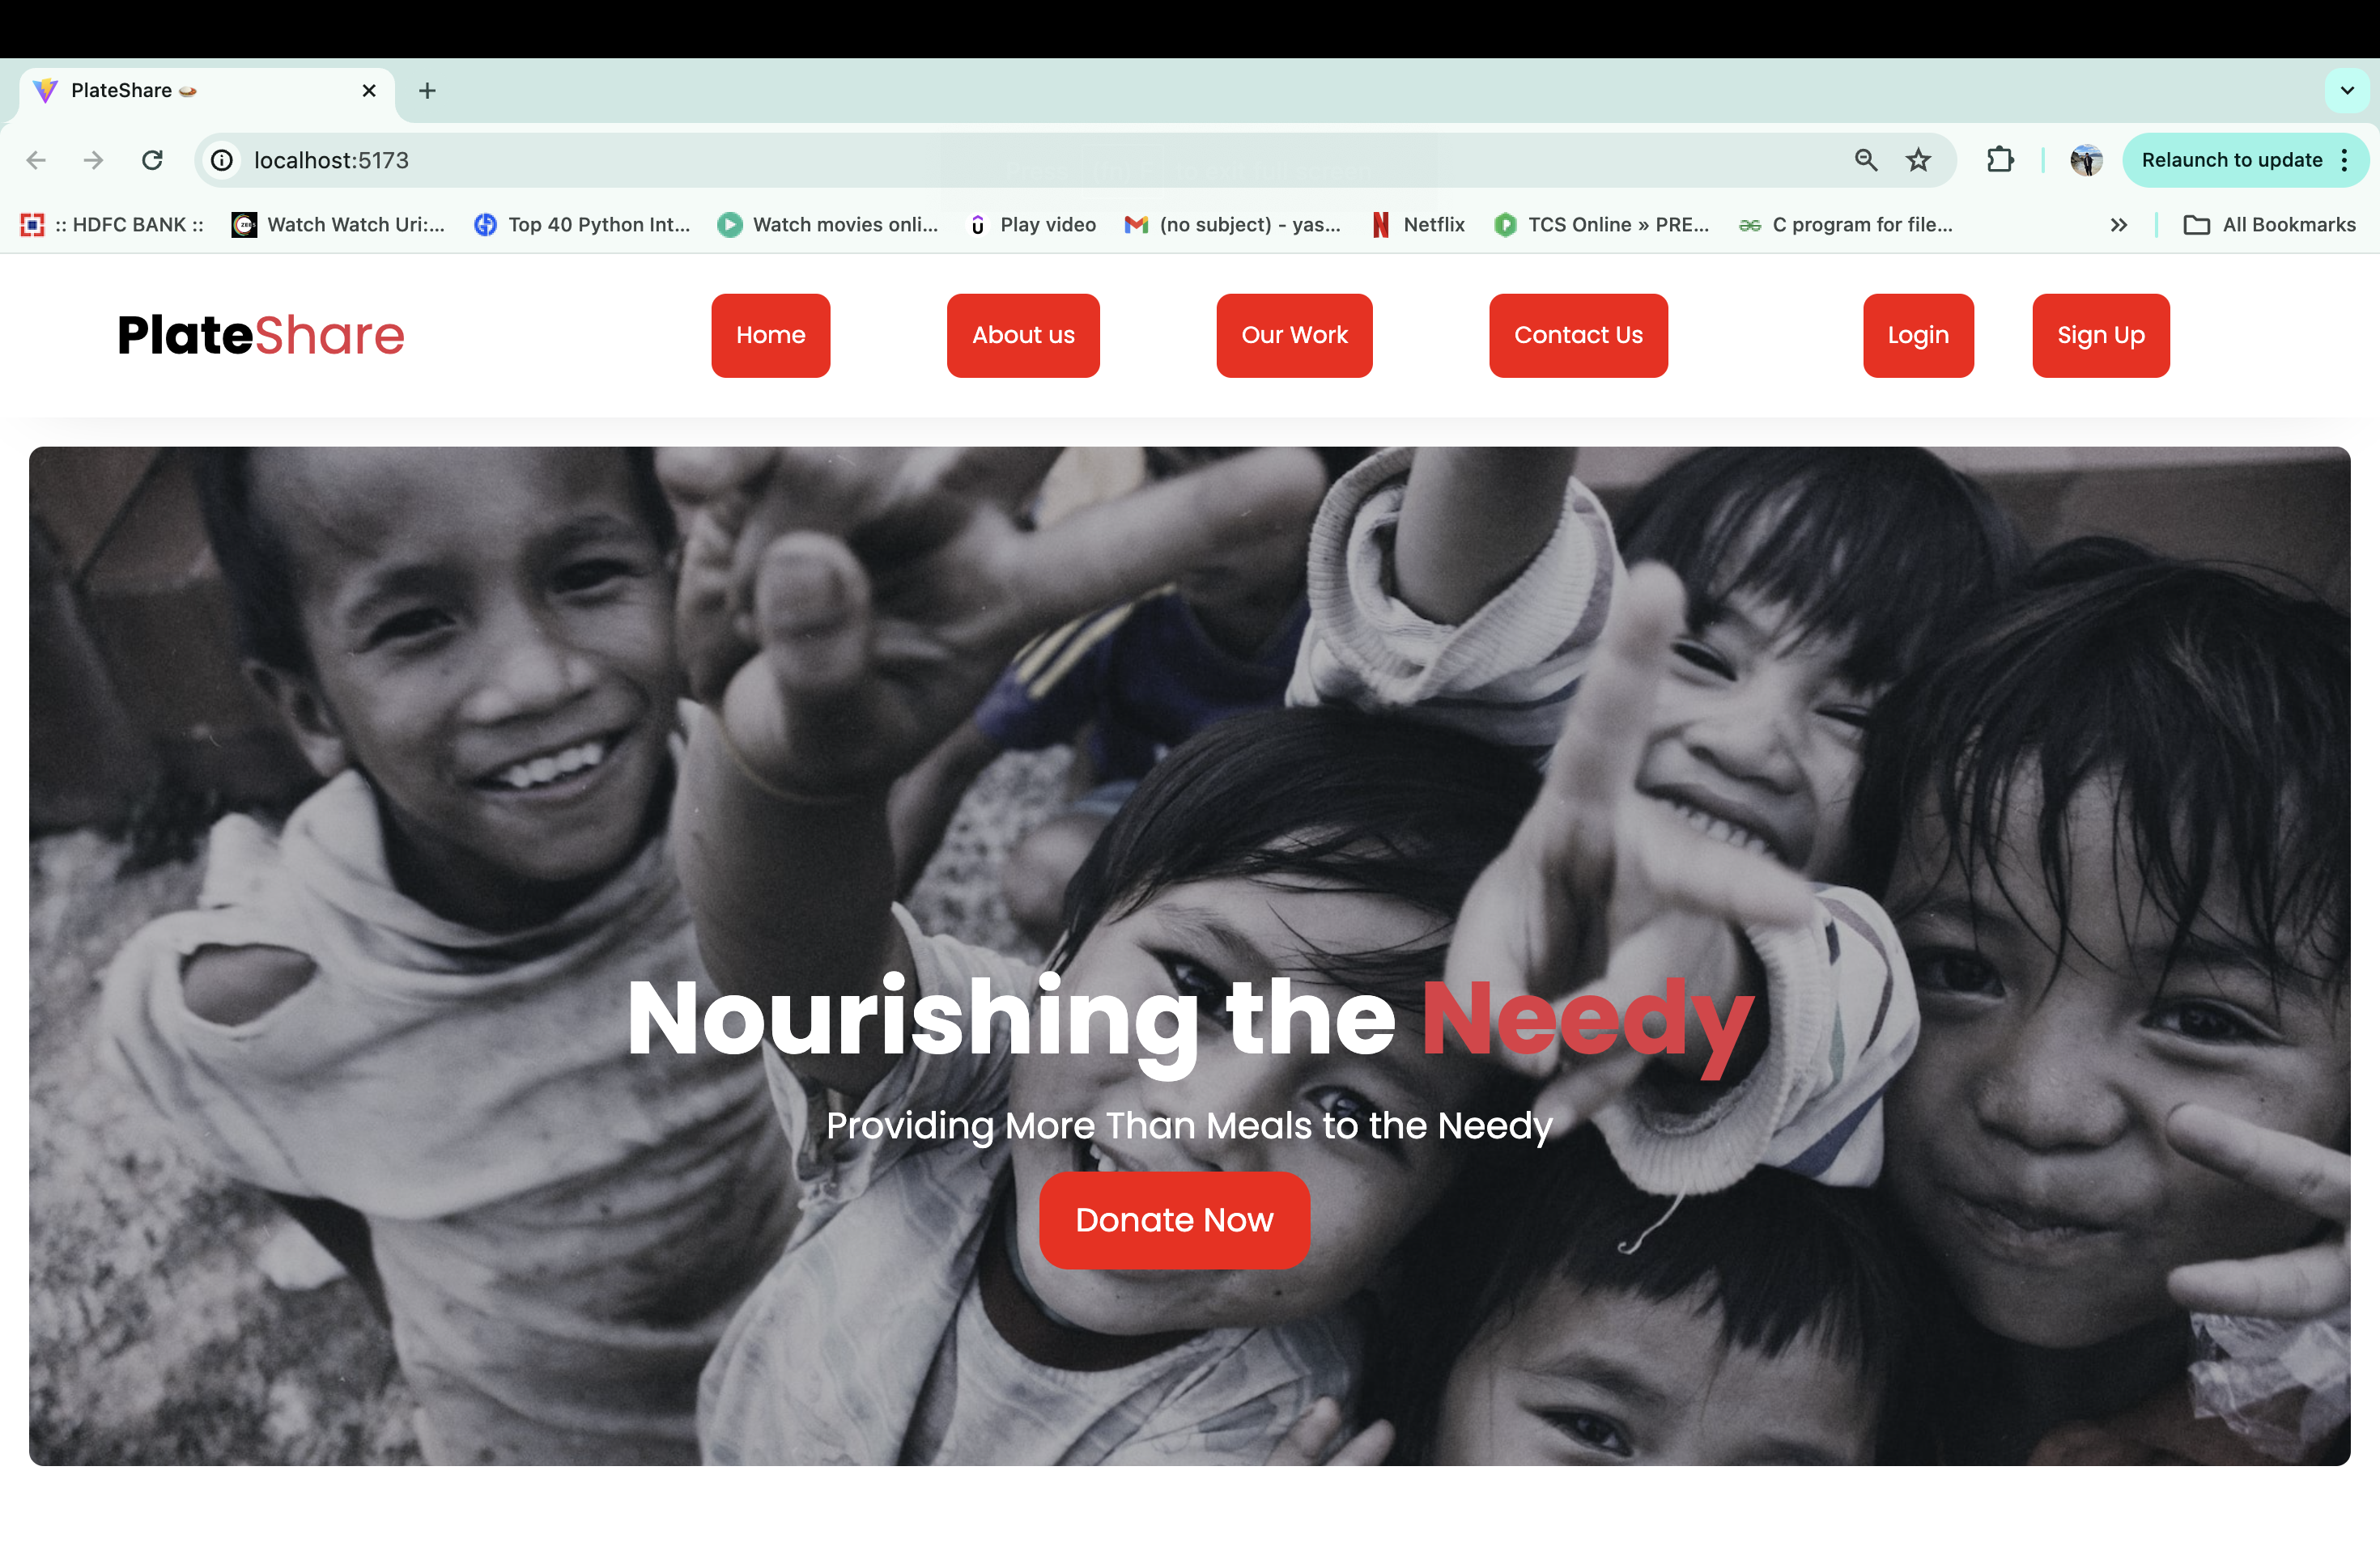
Home page

Slide 5
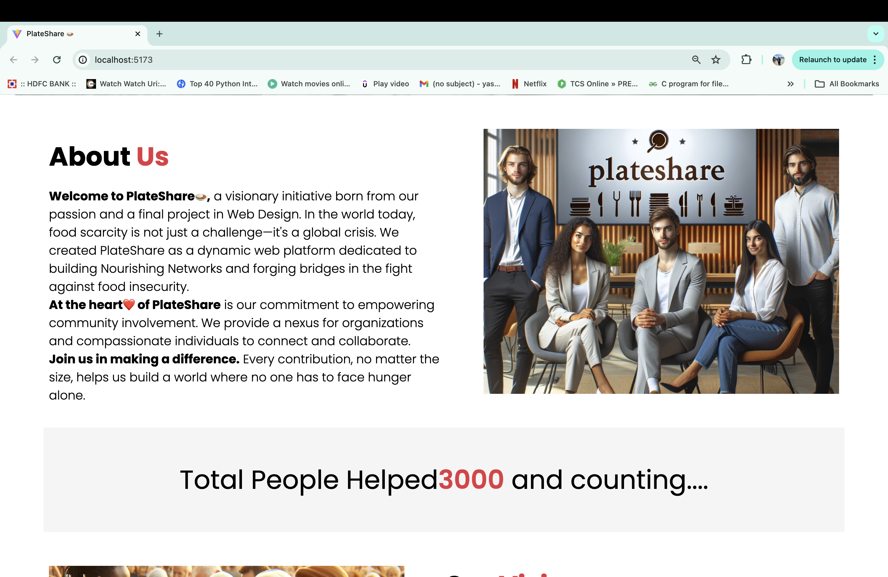
Home page >> About us

Slide 6
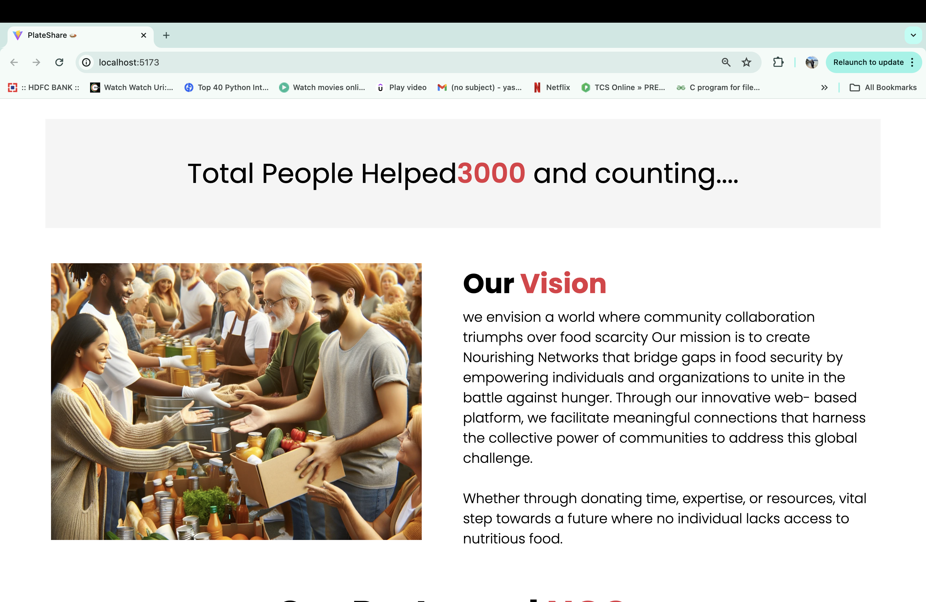
Home page >> Our vision

Slide 7
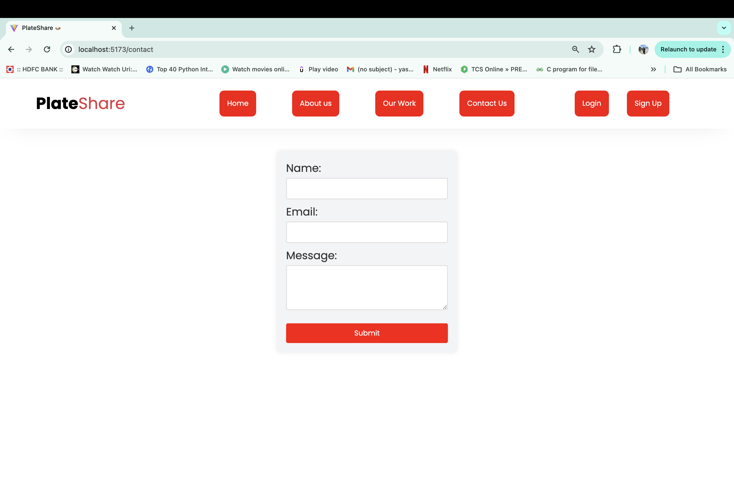
Home Page >> Contact us

Slide 8
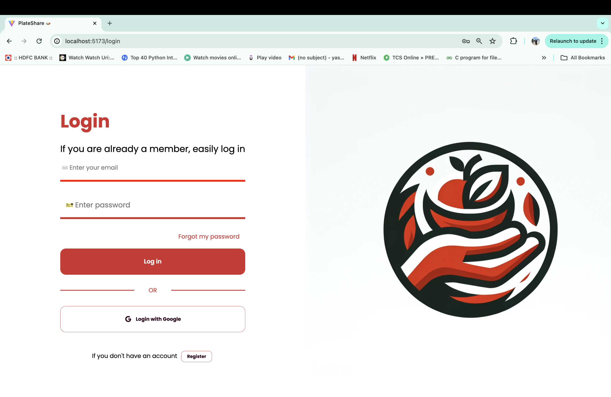
Home page >> Login

Slide 9
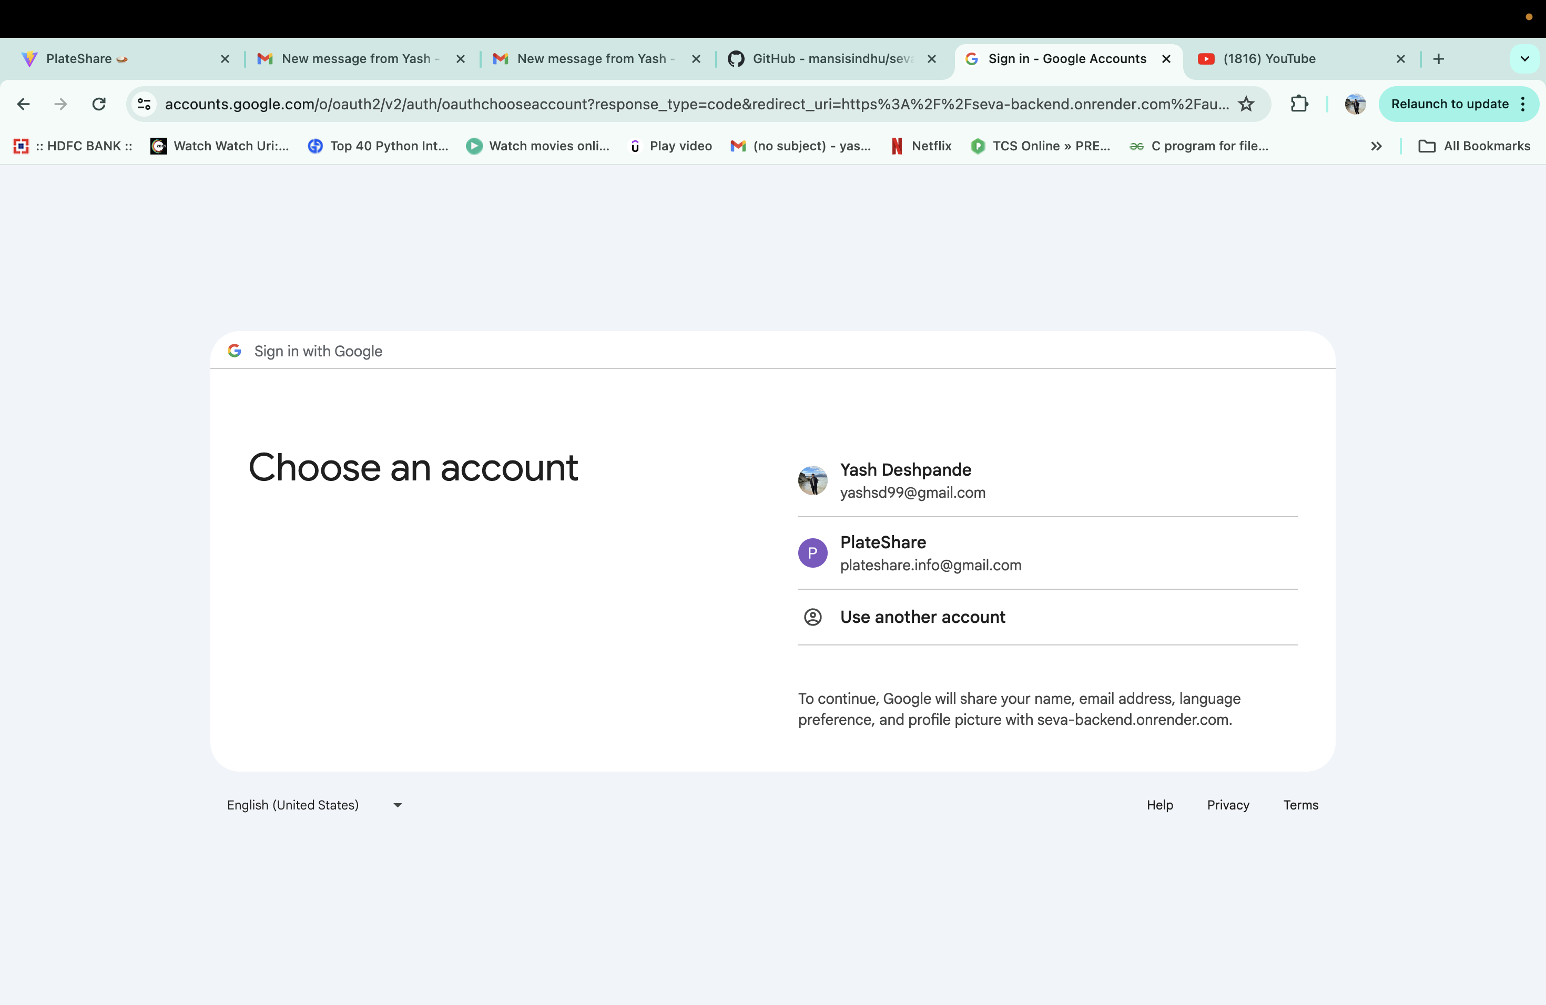
Google Login

Slide 10
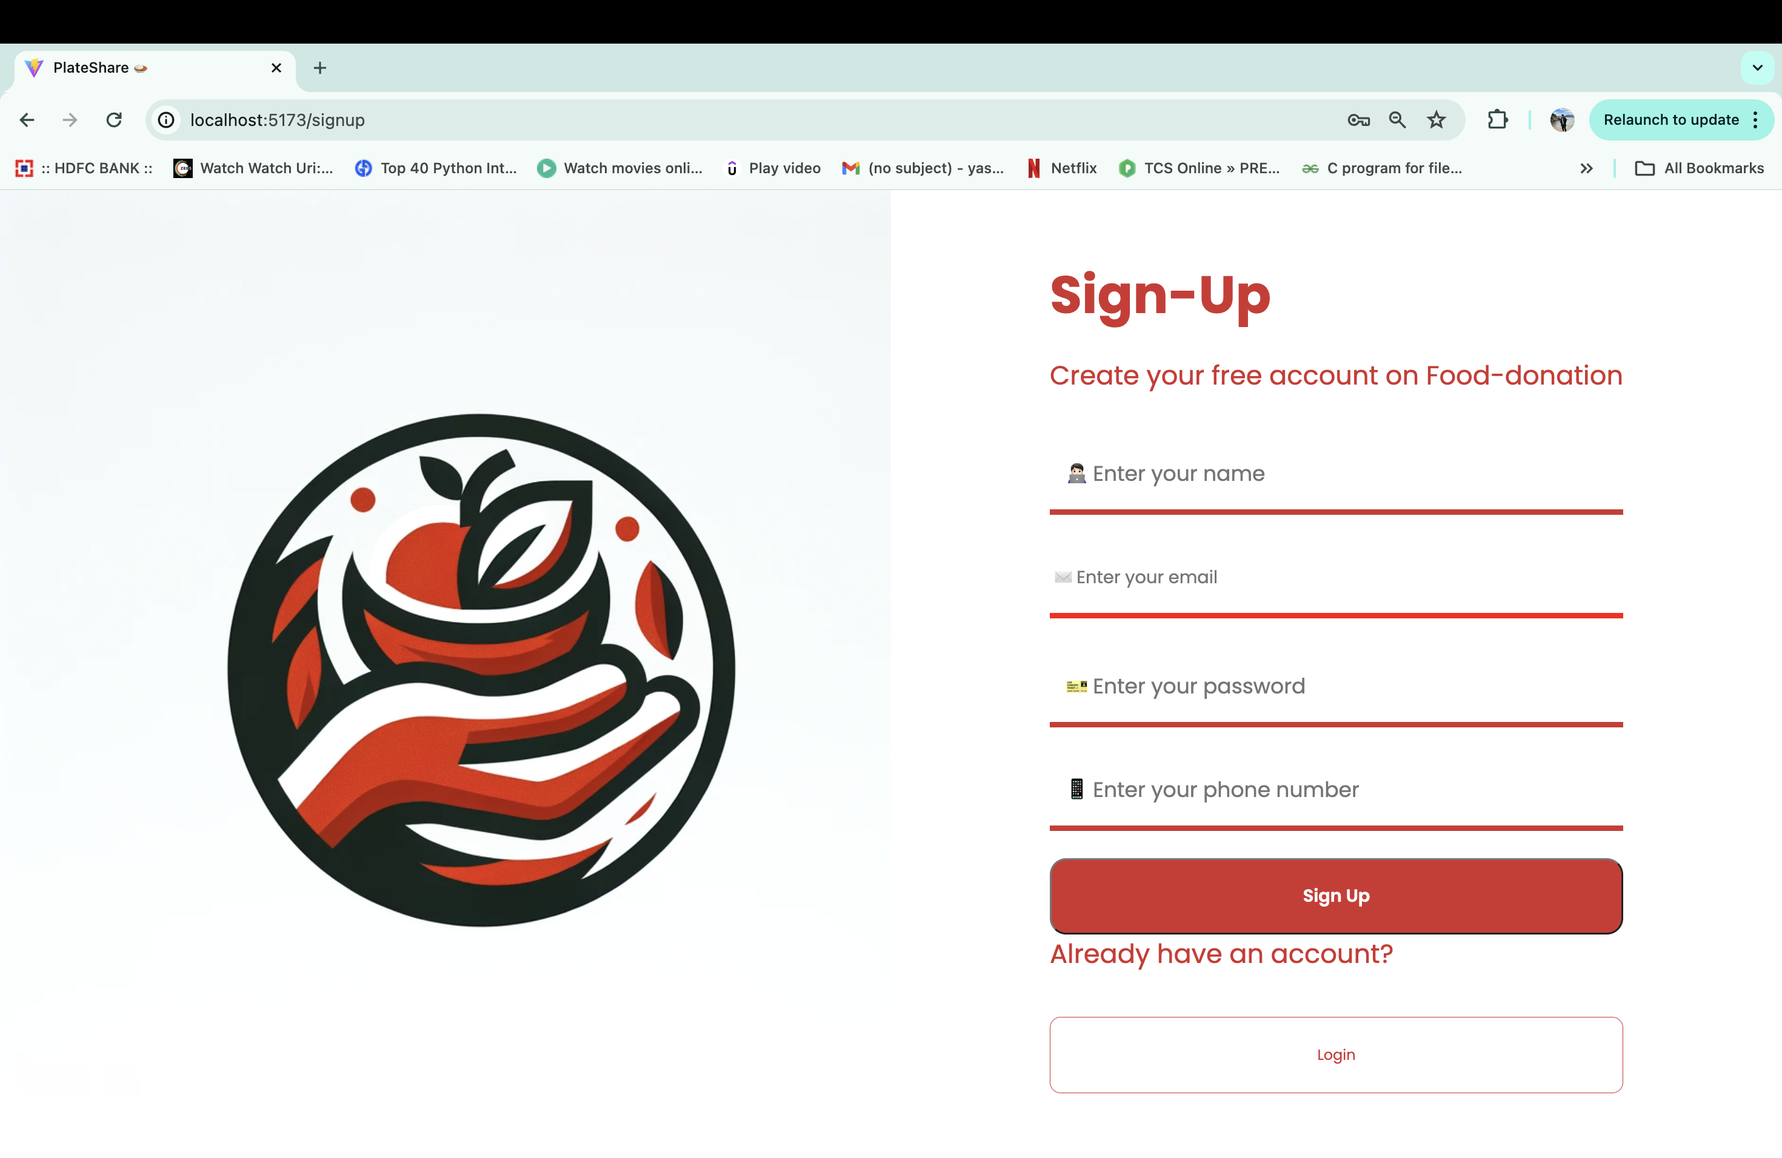
Home Page >> Signup

Slide 11
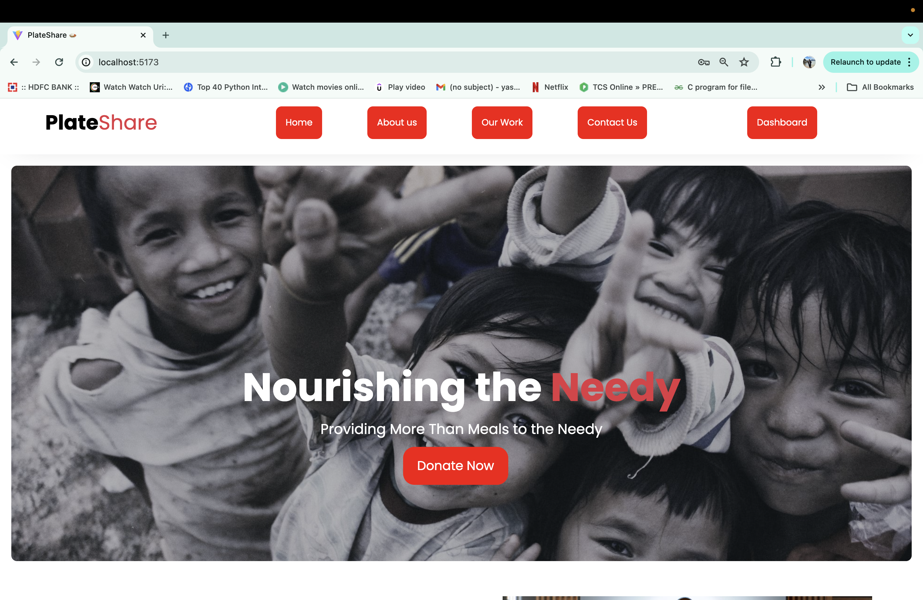
After Login >> Dashboard Button

Slide 12
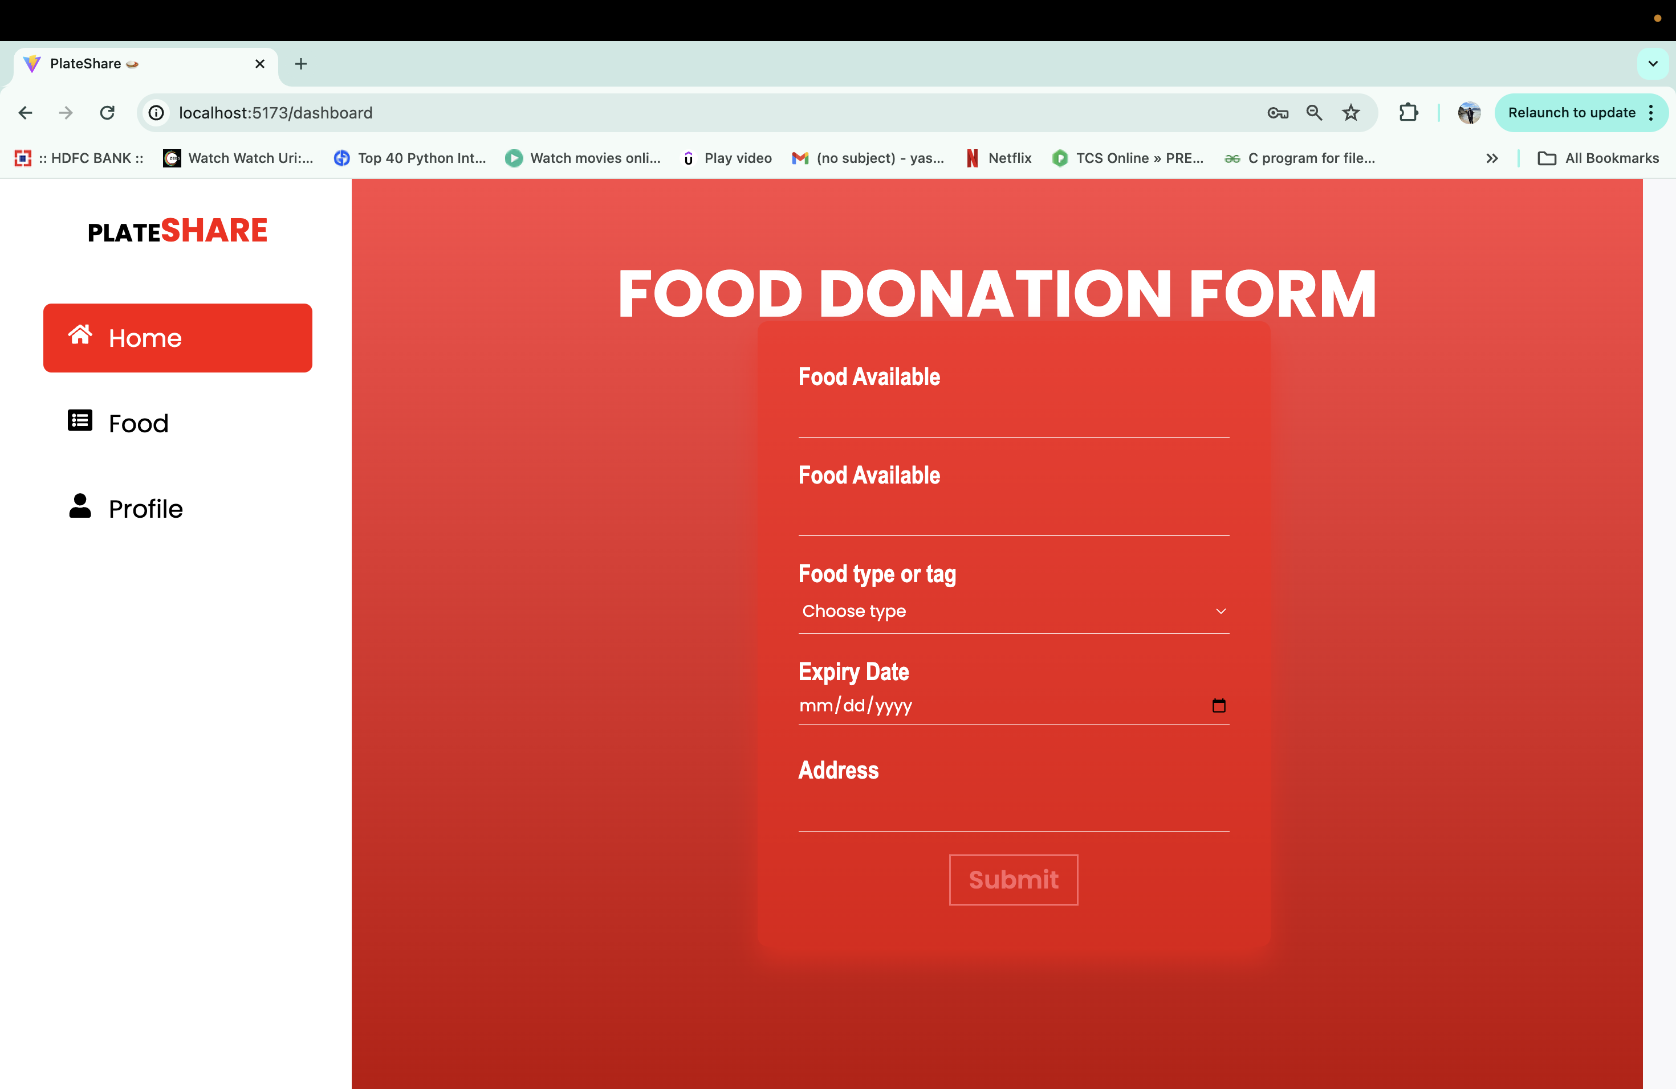
Dashboard Button >>

Slide 13

Food Donation Form

Slide 14
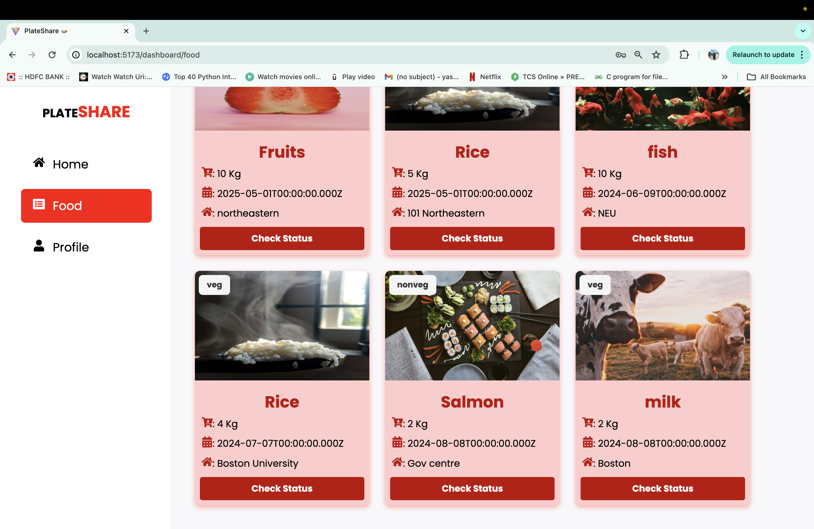
Food Cart Page

Slide 15
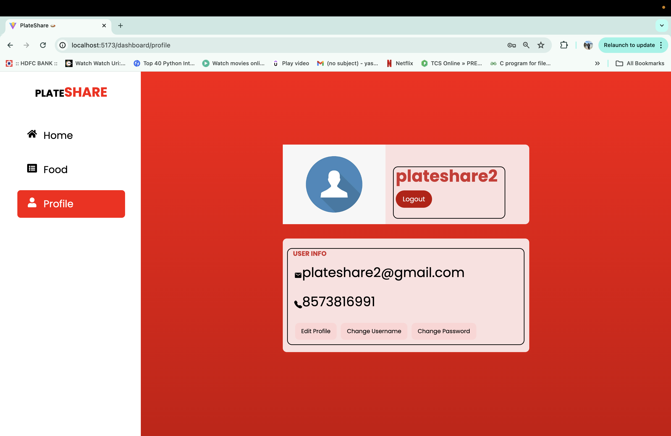
Profile Page

Slide 16
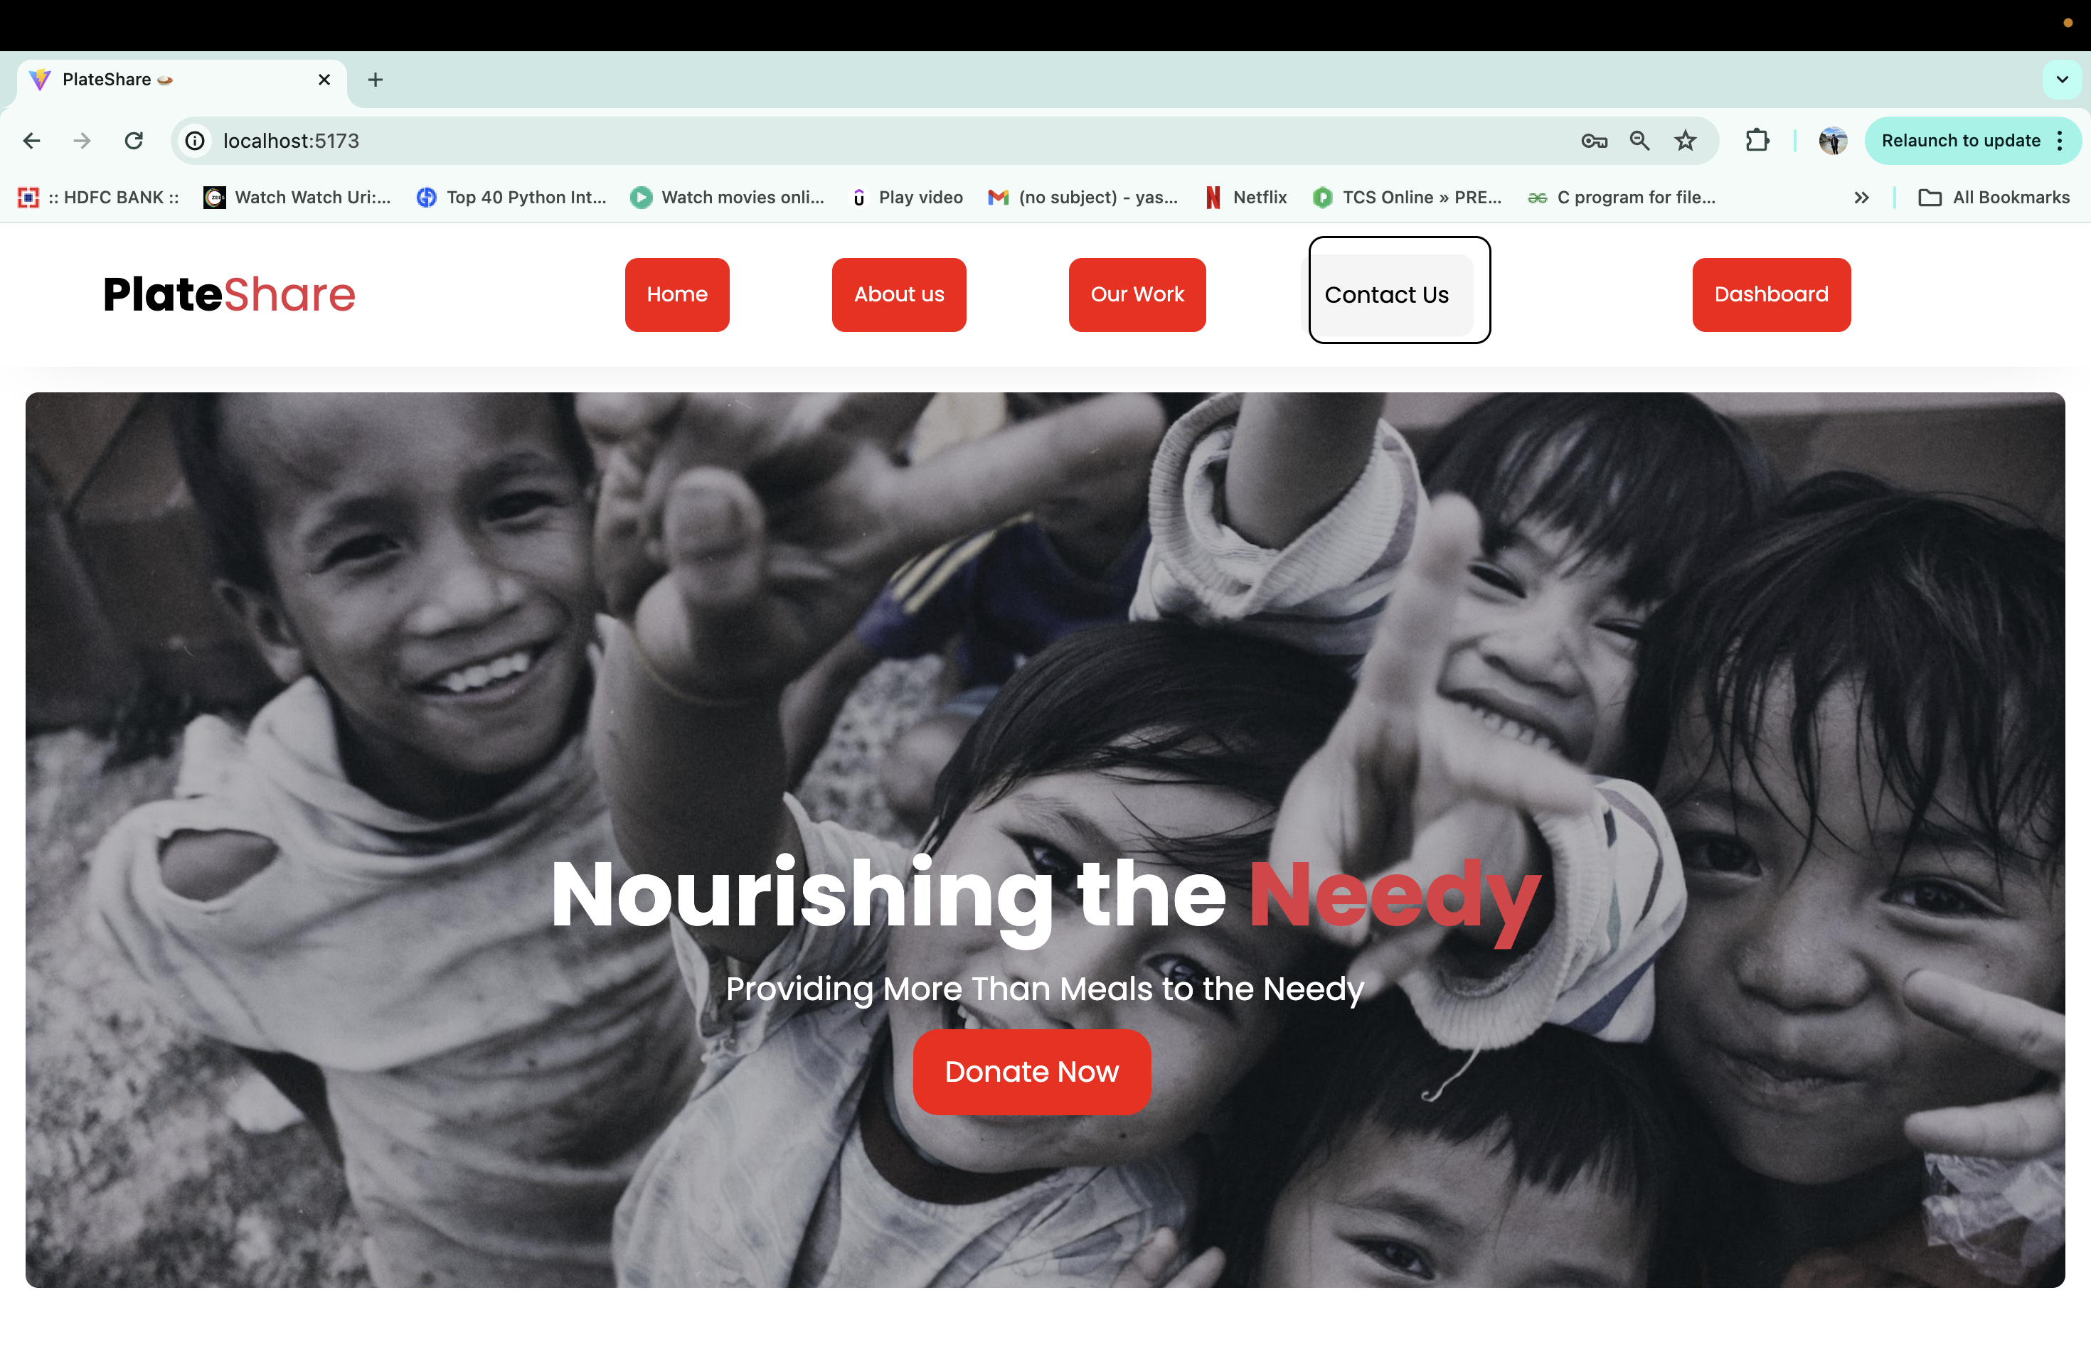
Contact us Button >>

Slide 17
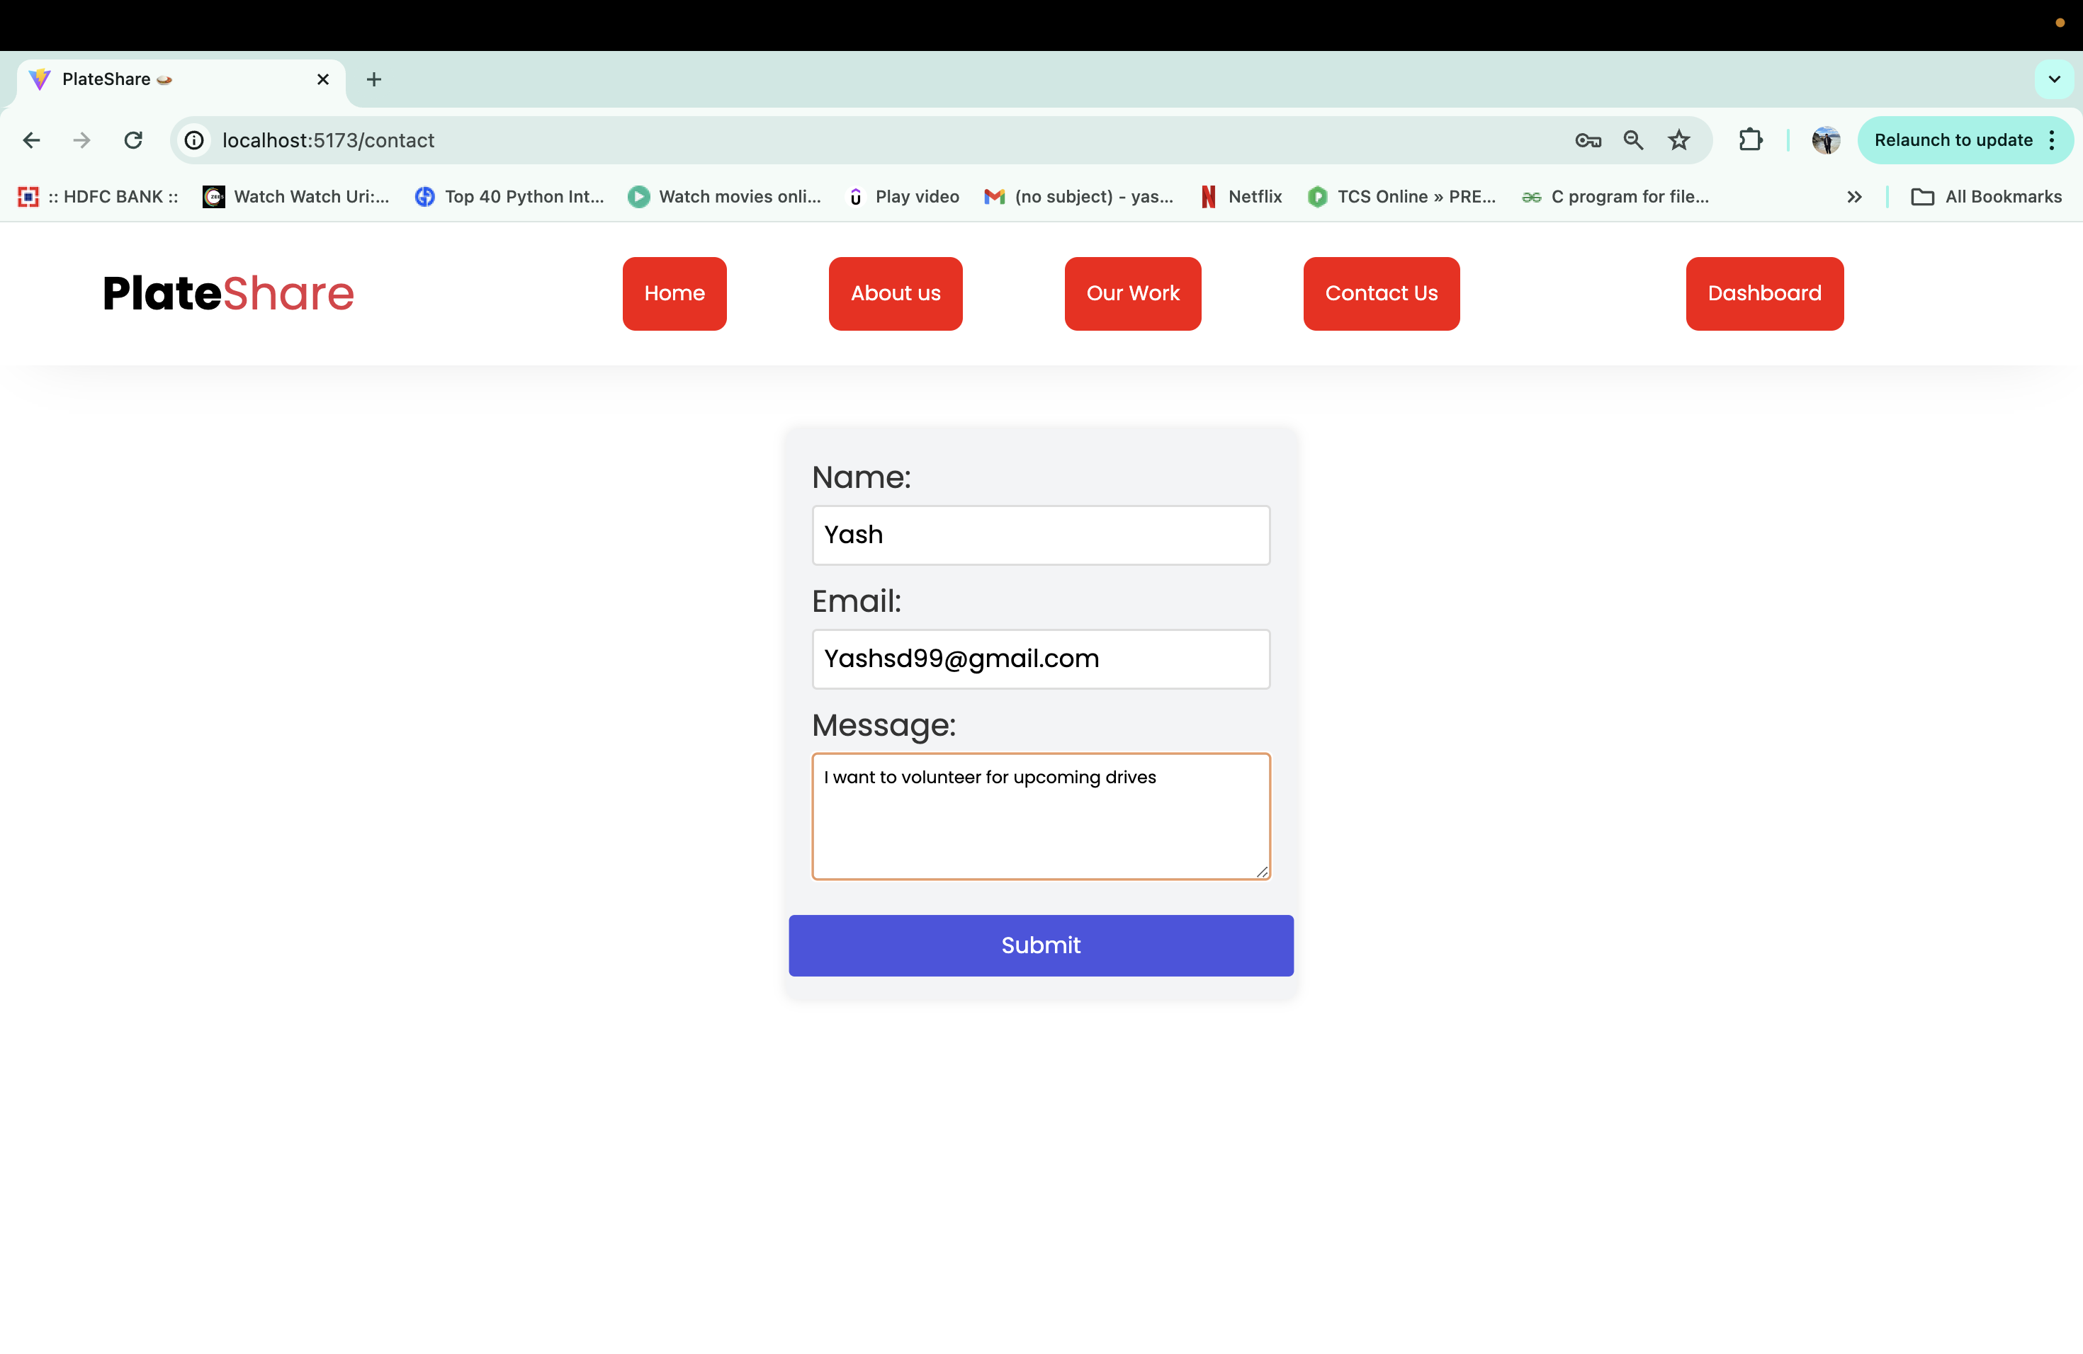
Contact info submission

Slide 18
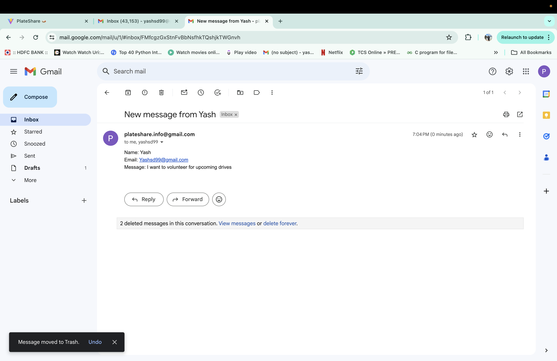
Mail will sent to PlateShare Team

Slide 19
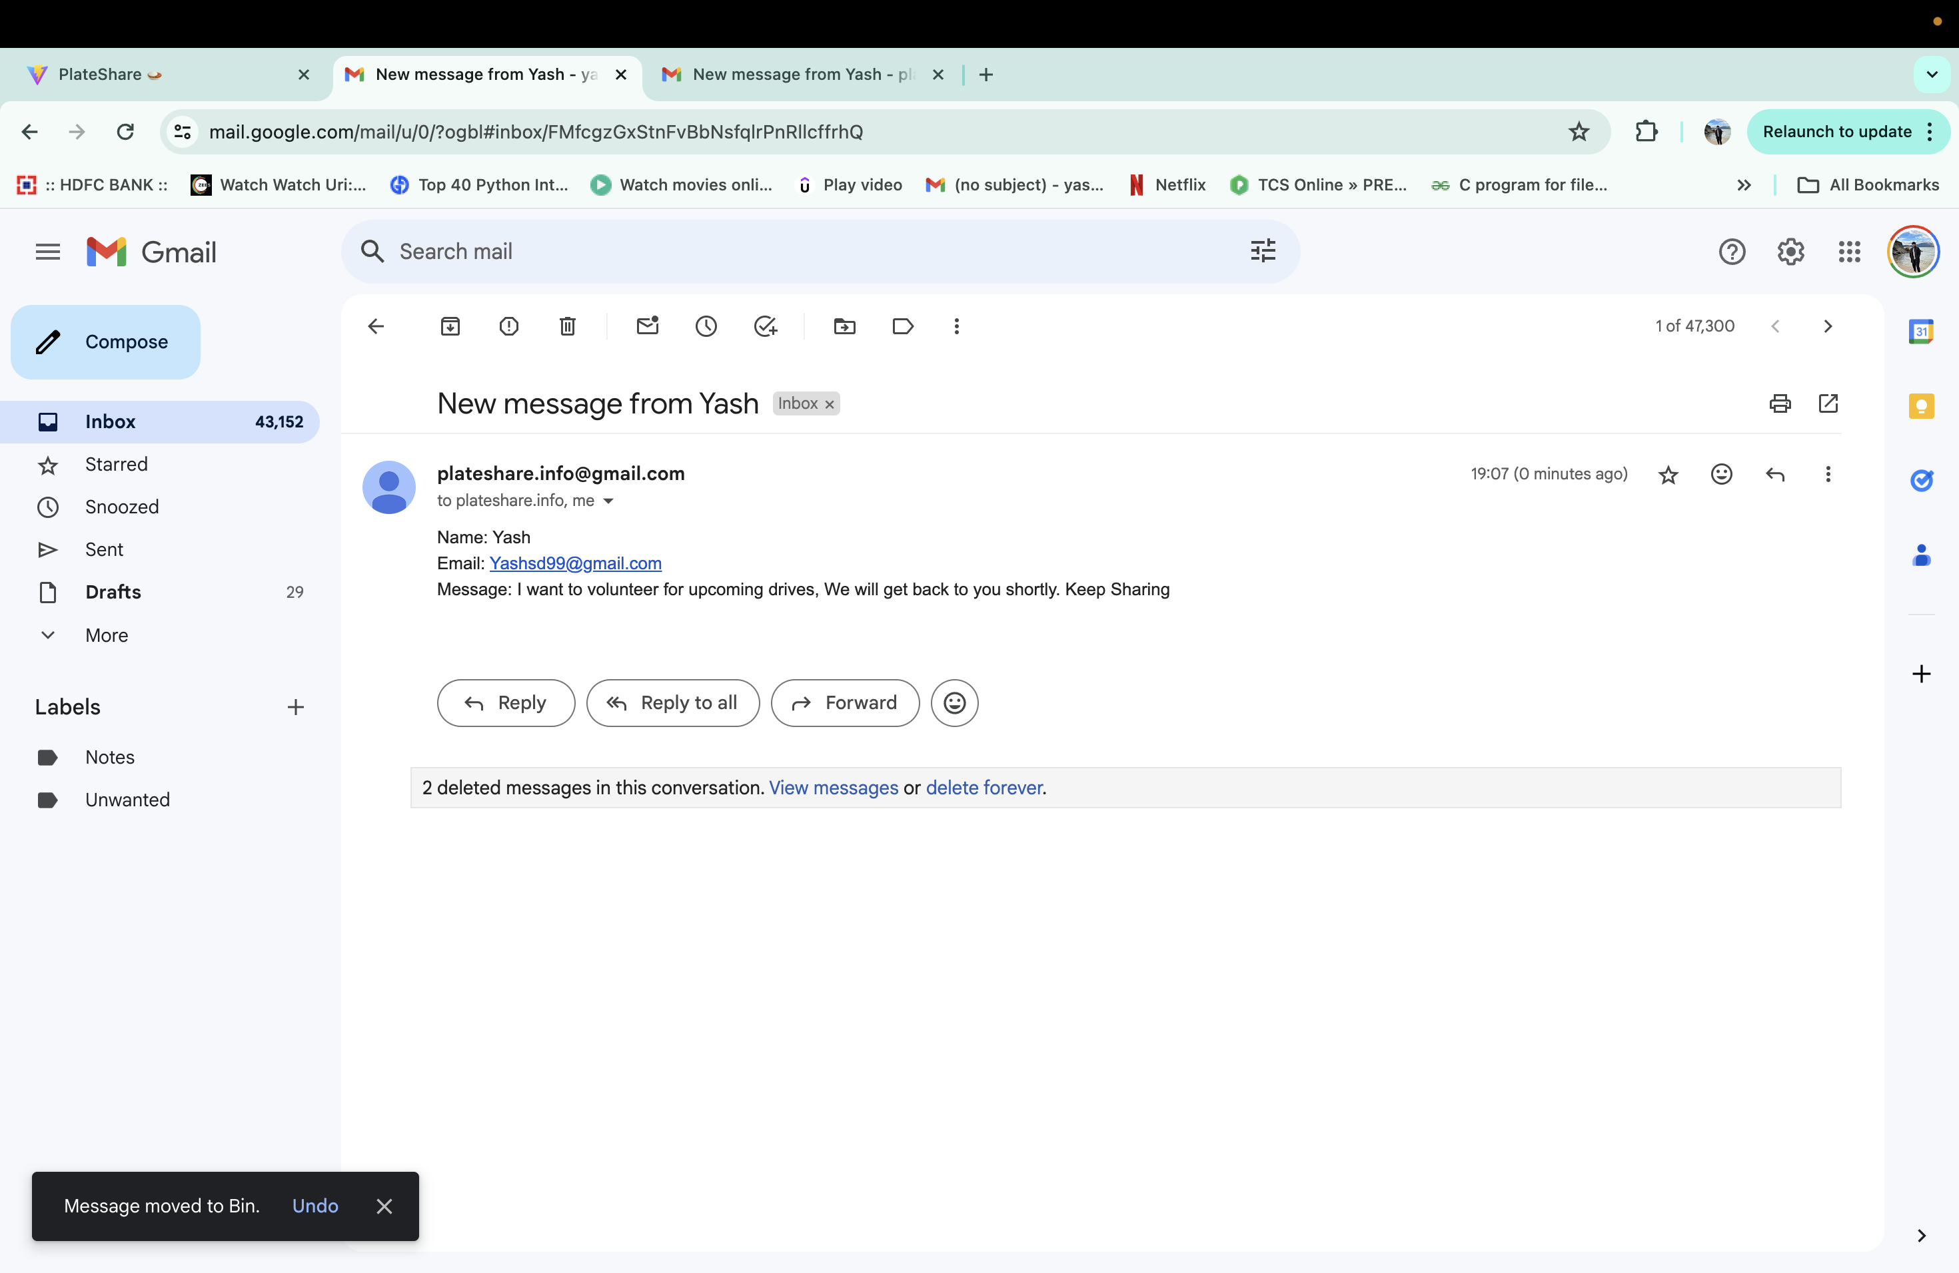
Mail will be sent to User

Slide 20
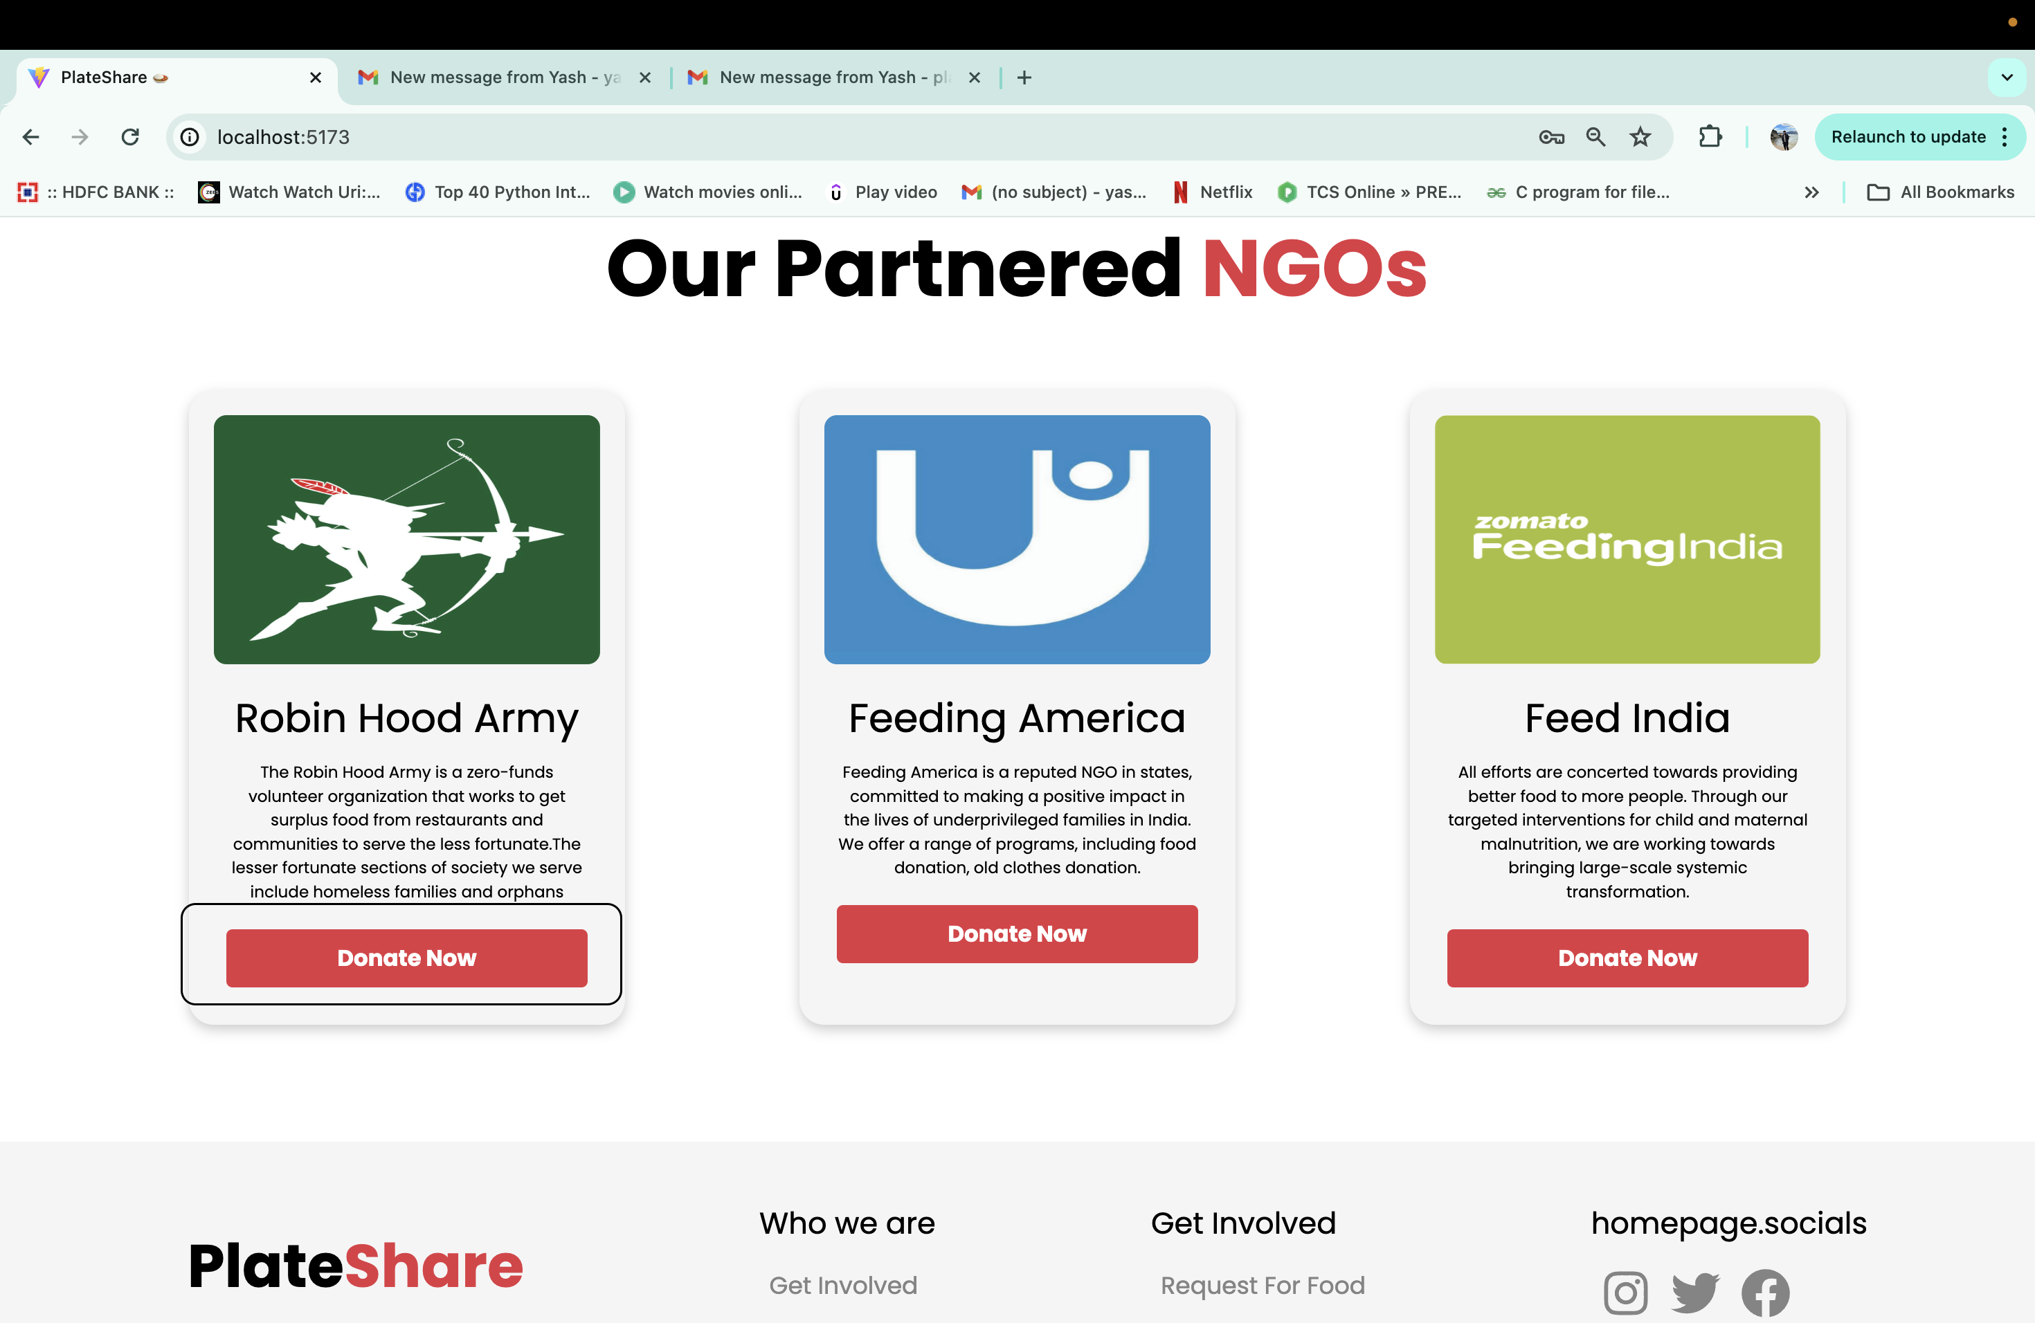
NGO Donate Now >>

Slide 21
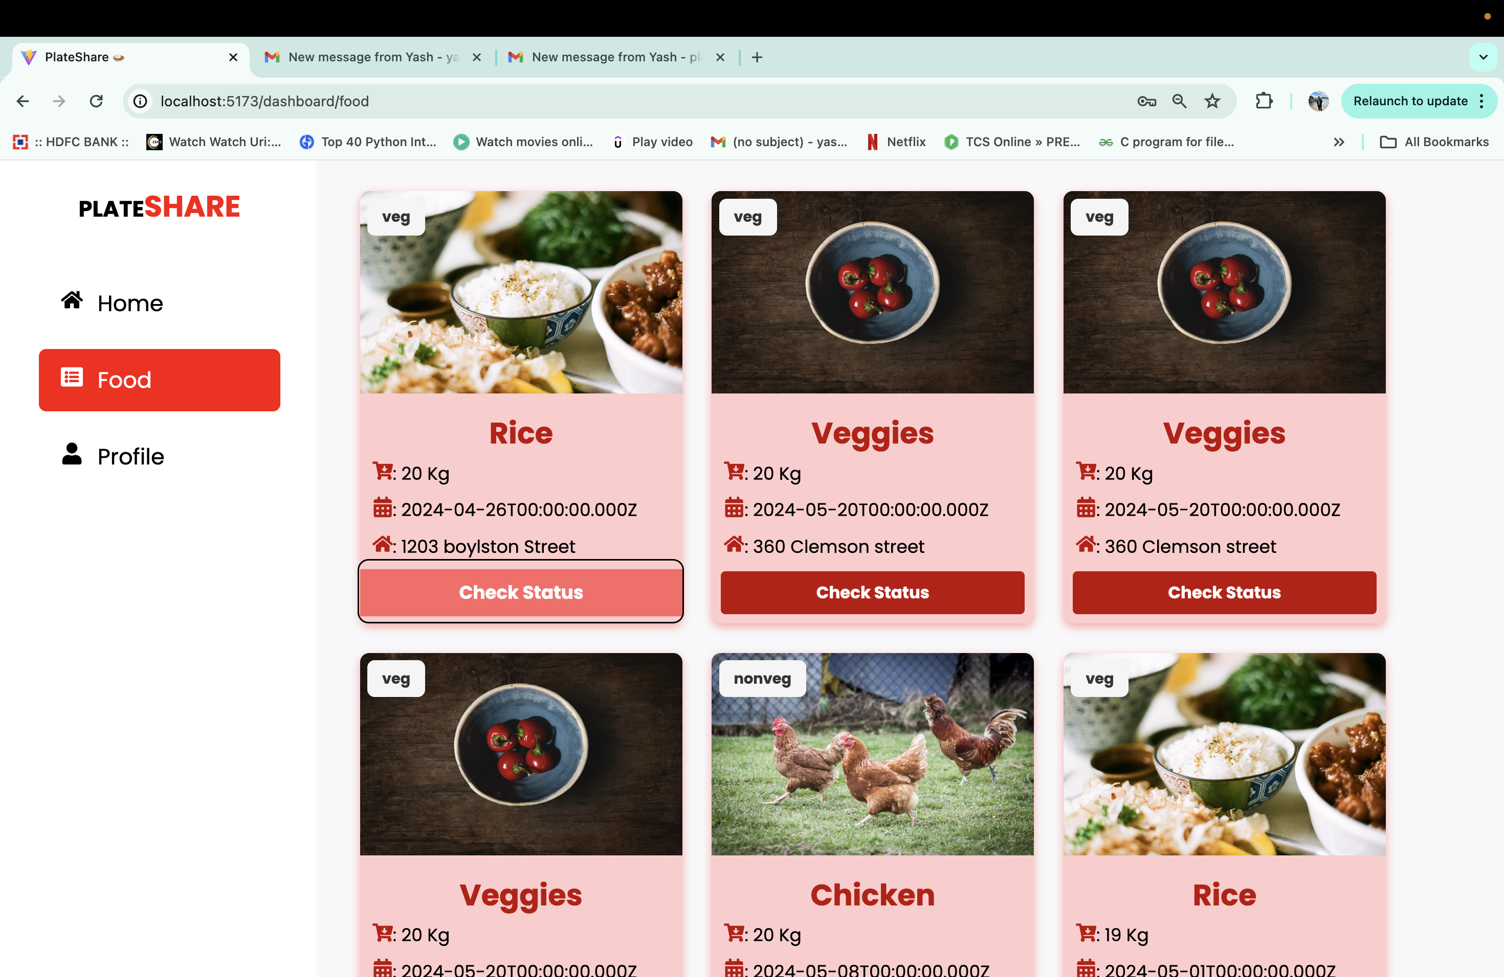
Food Donation Page
Only Donation Food page will have access to check the status of Food

Slide 22
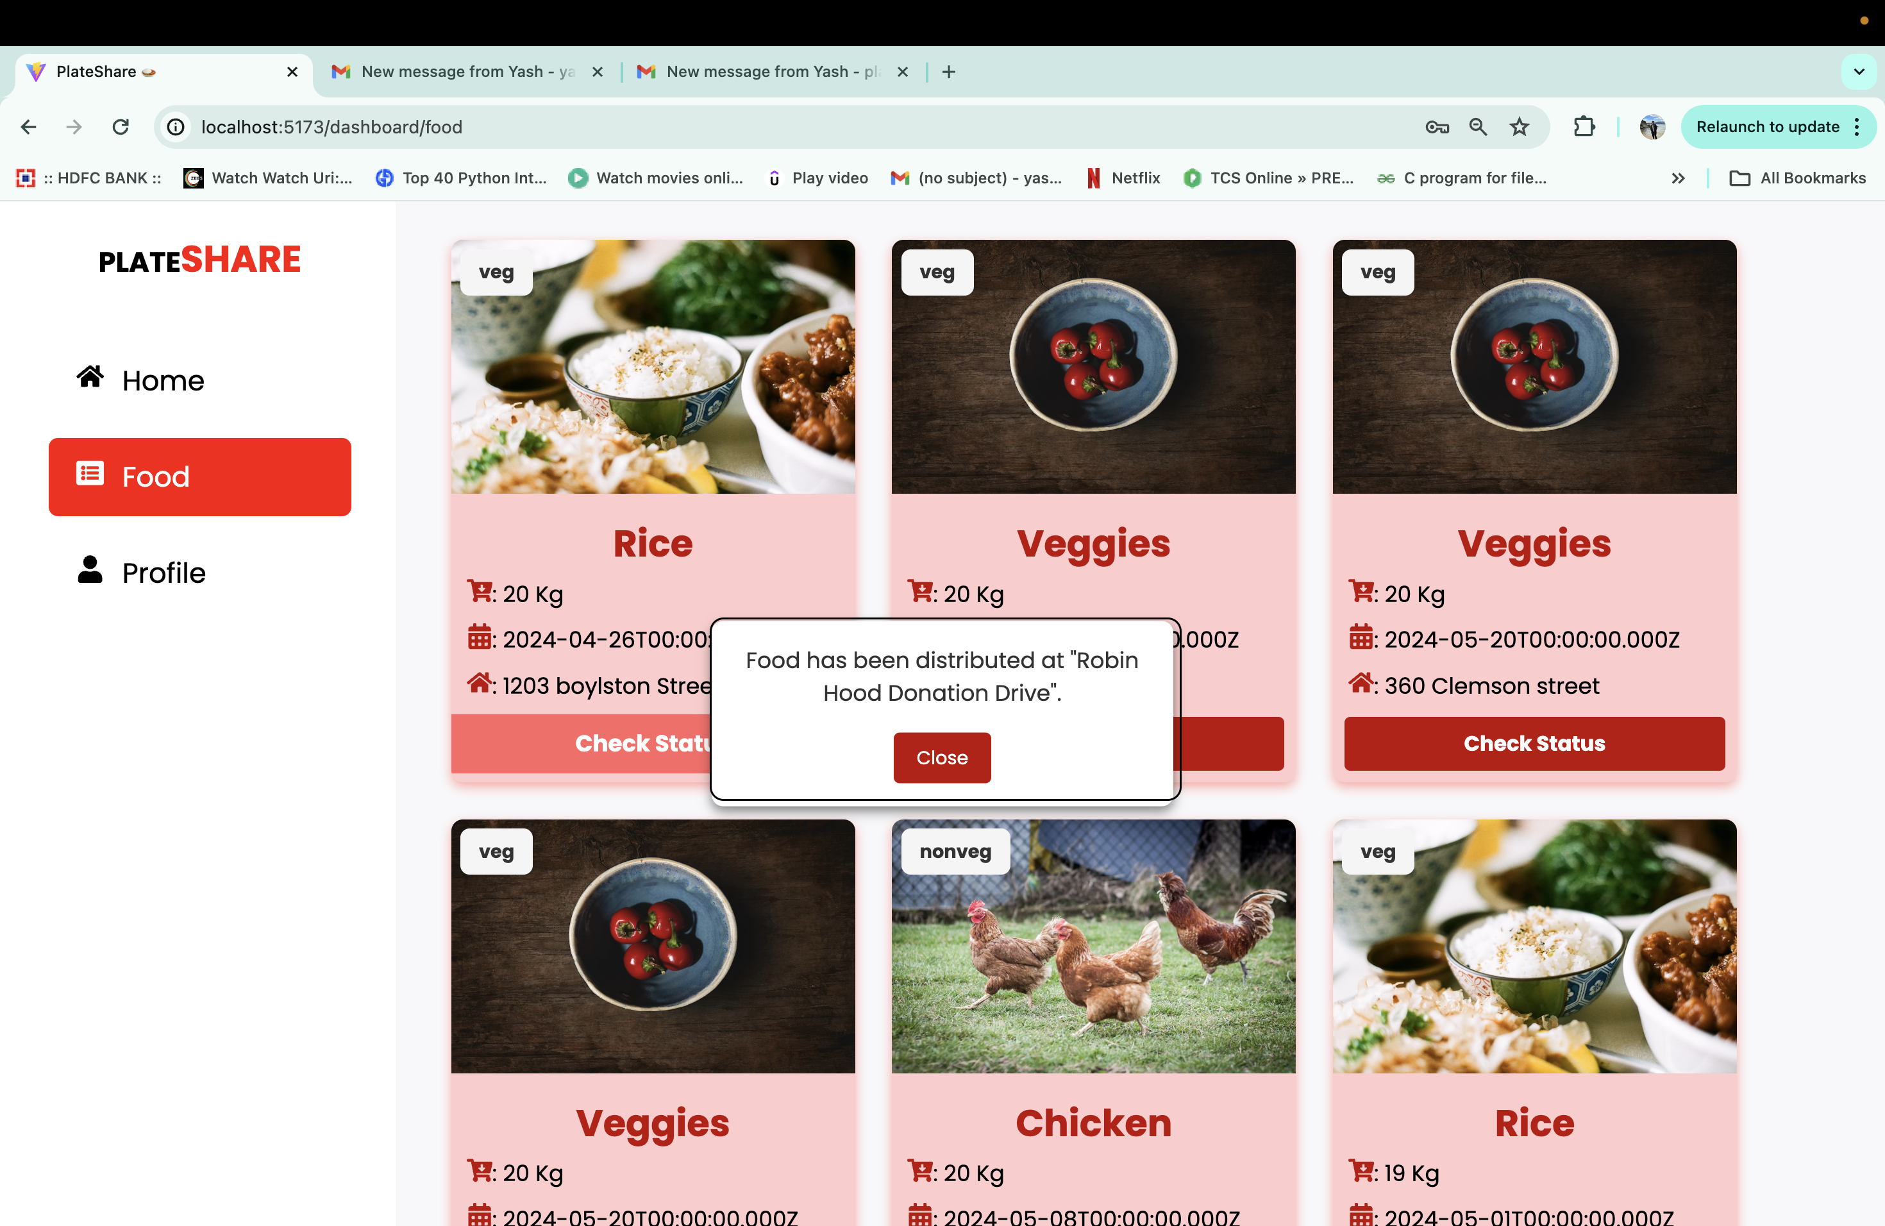
Check Status >>
Will gave status if the food has been donated or distributed or not

Slide 23
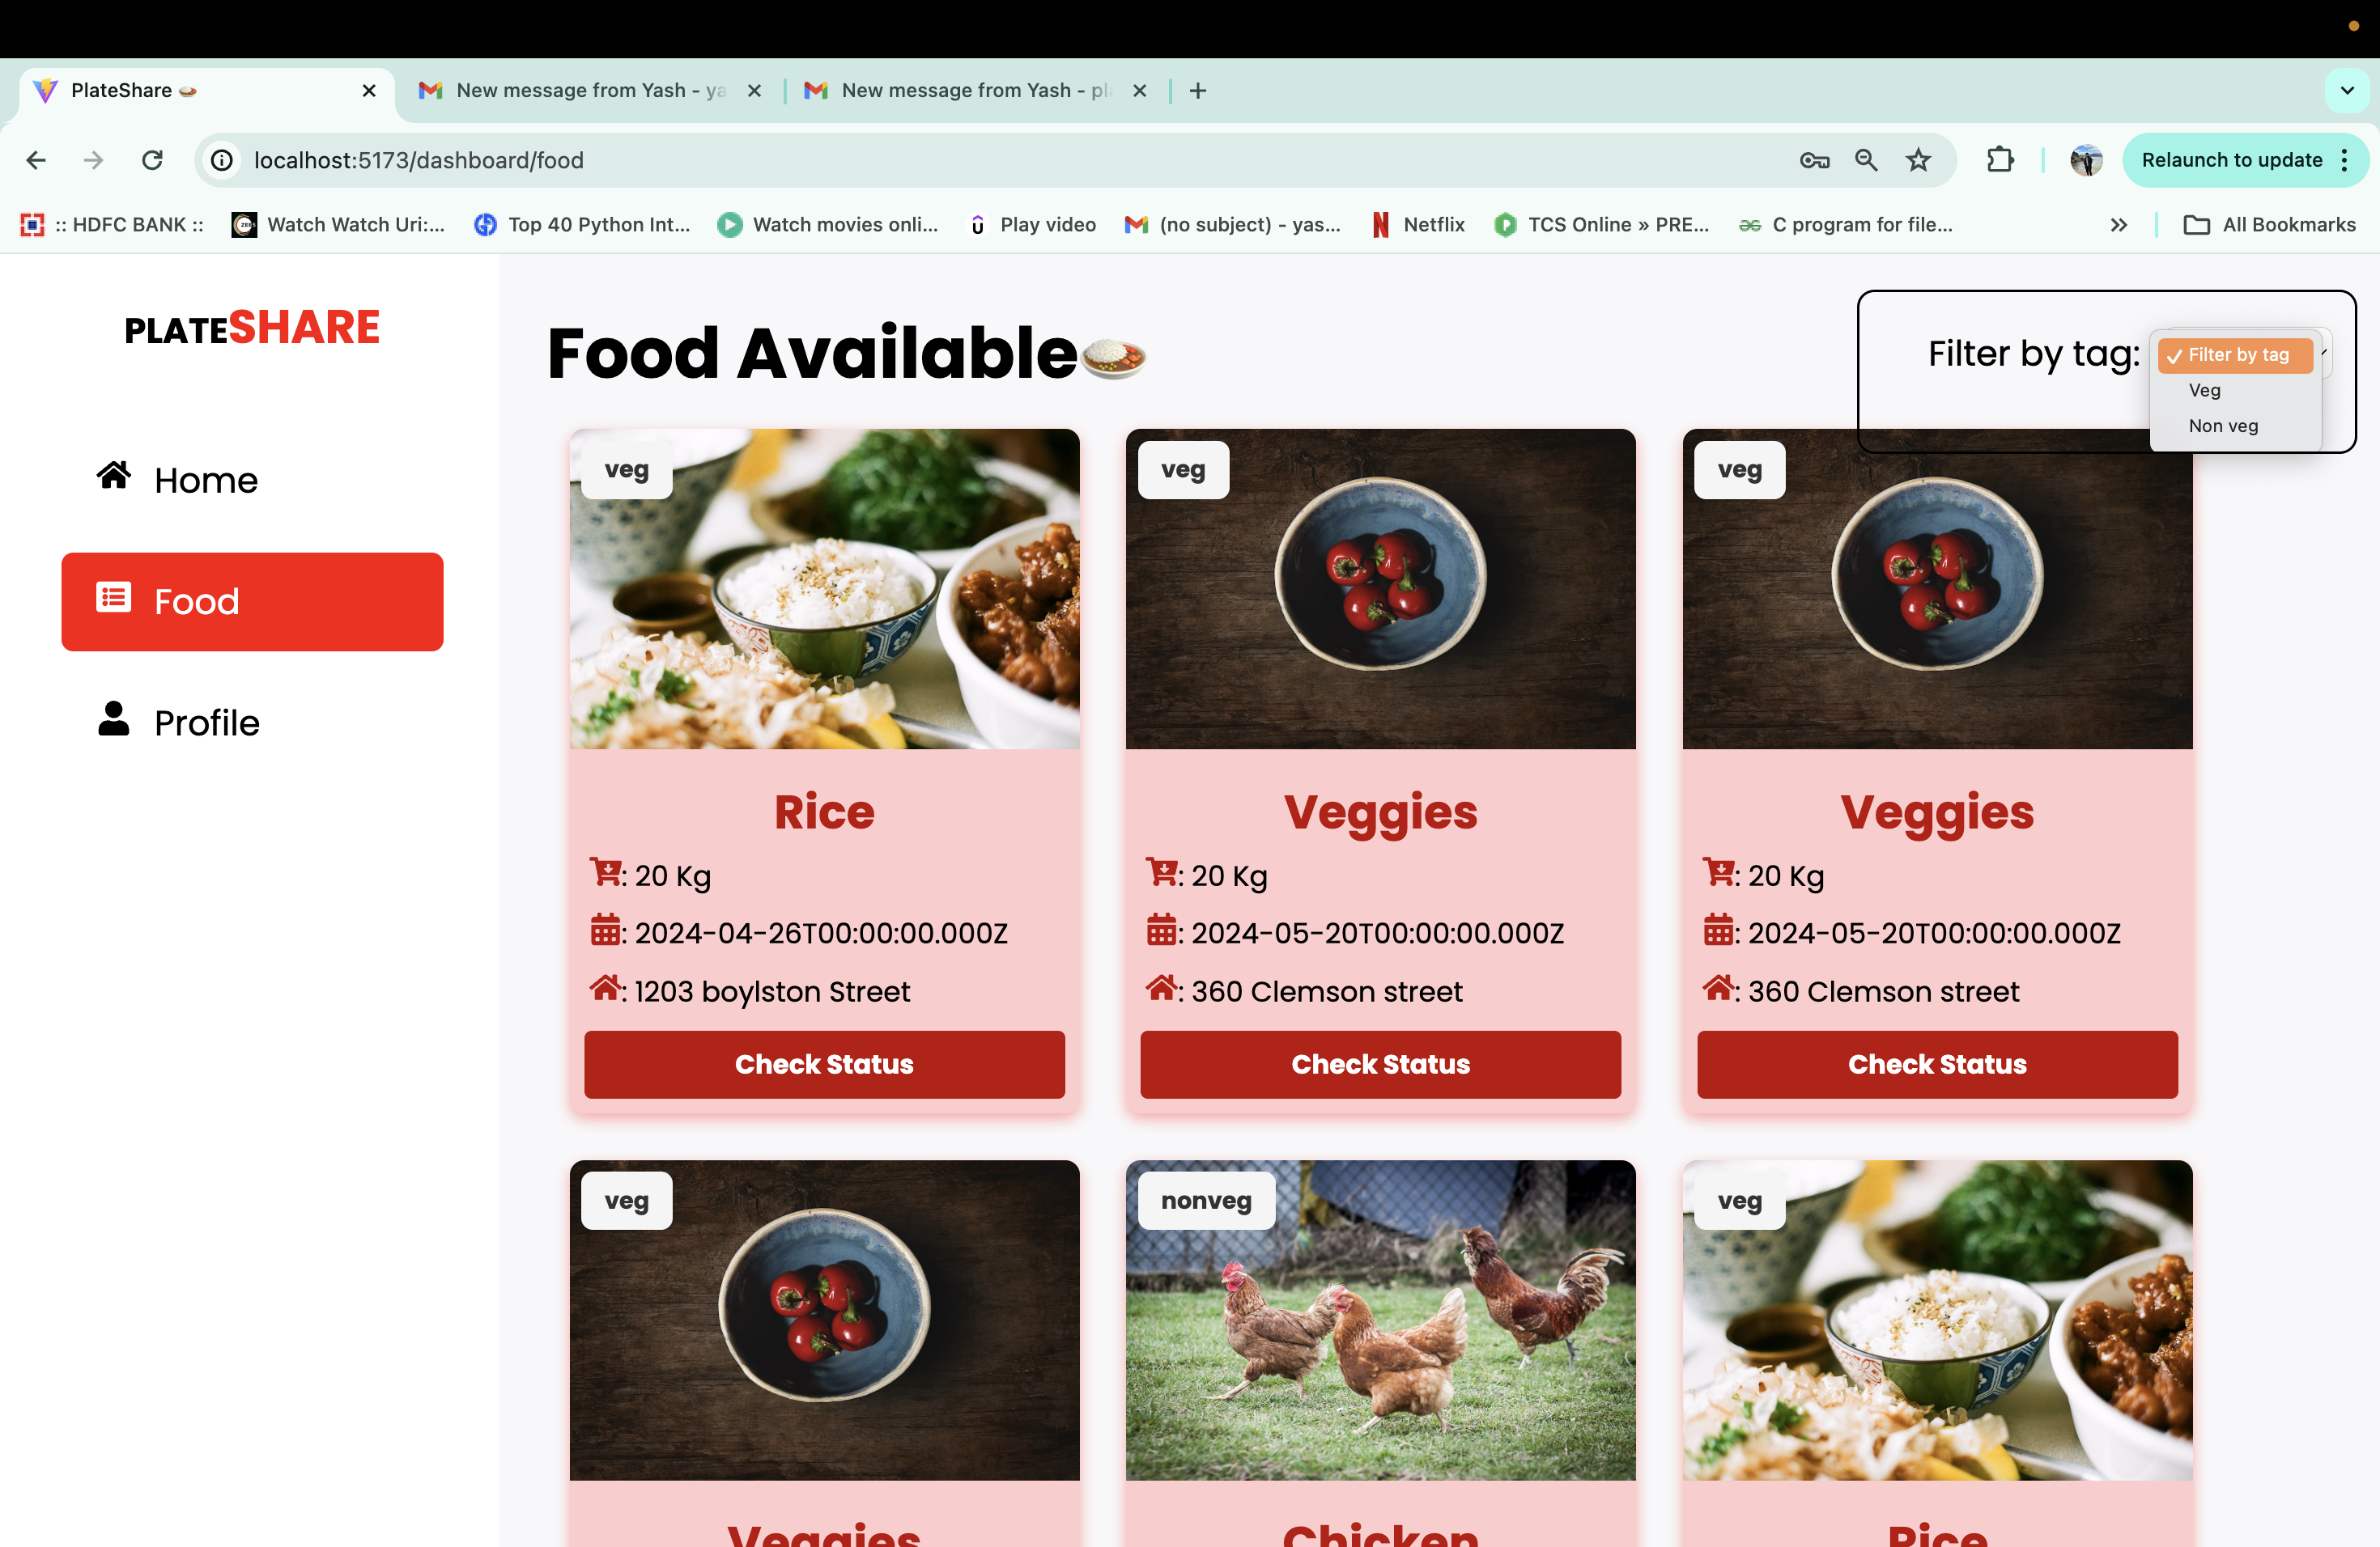
Filter tag>> Veg/Non Veg

Slide 24
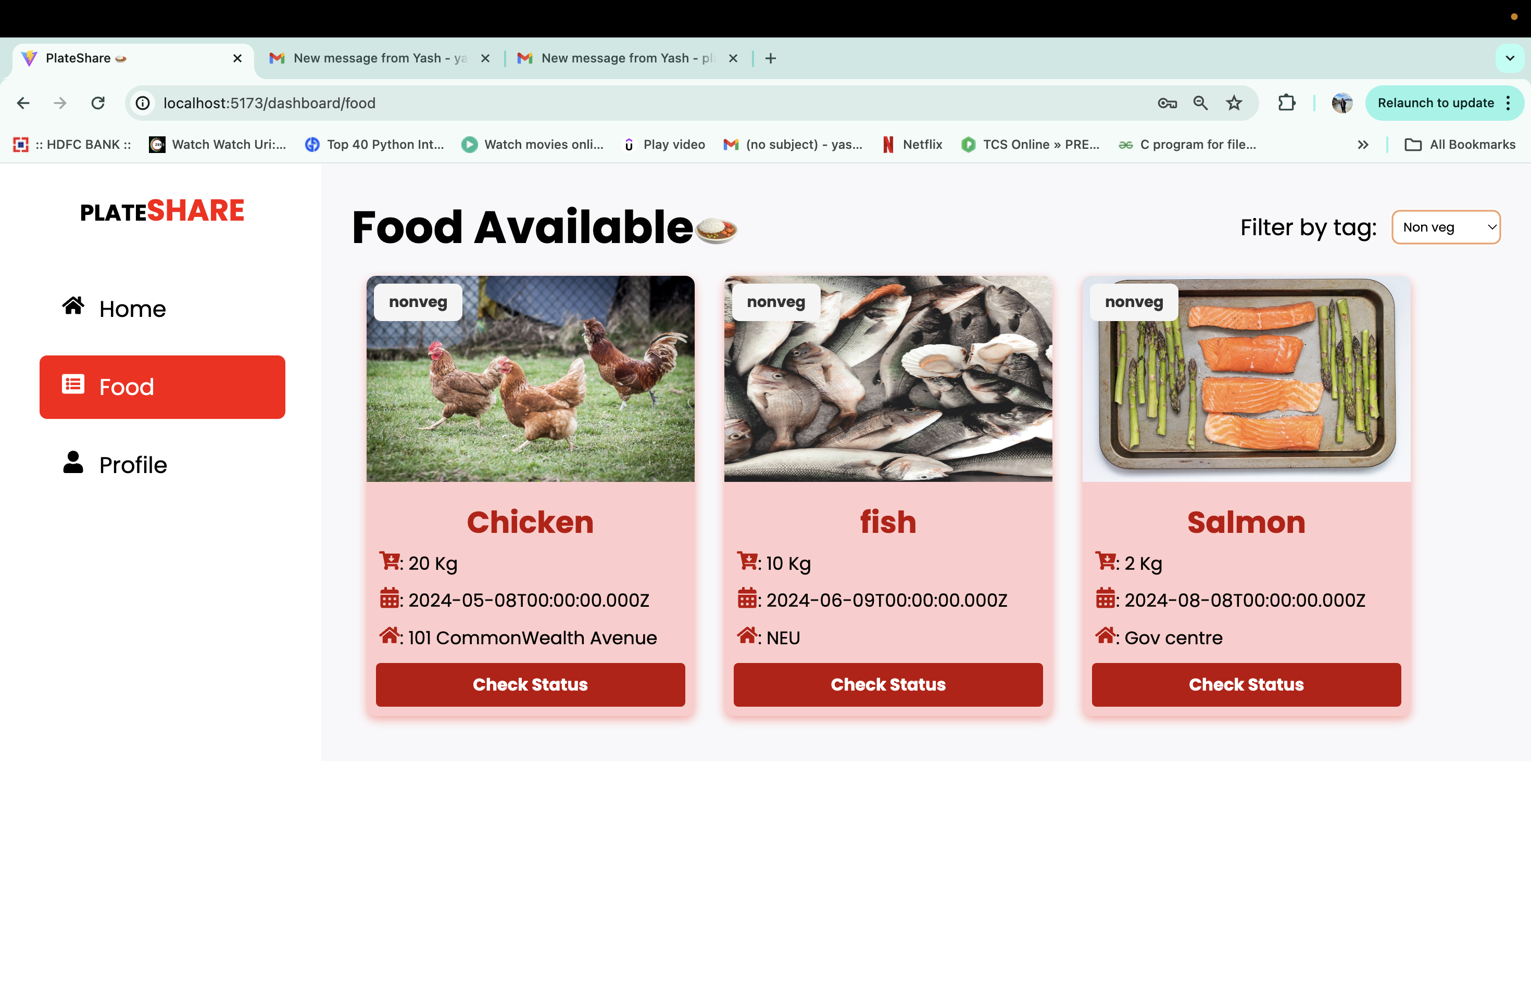
Filter tag >> Non Veg

Slide 25
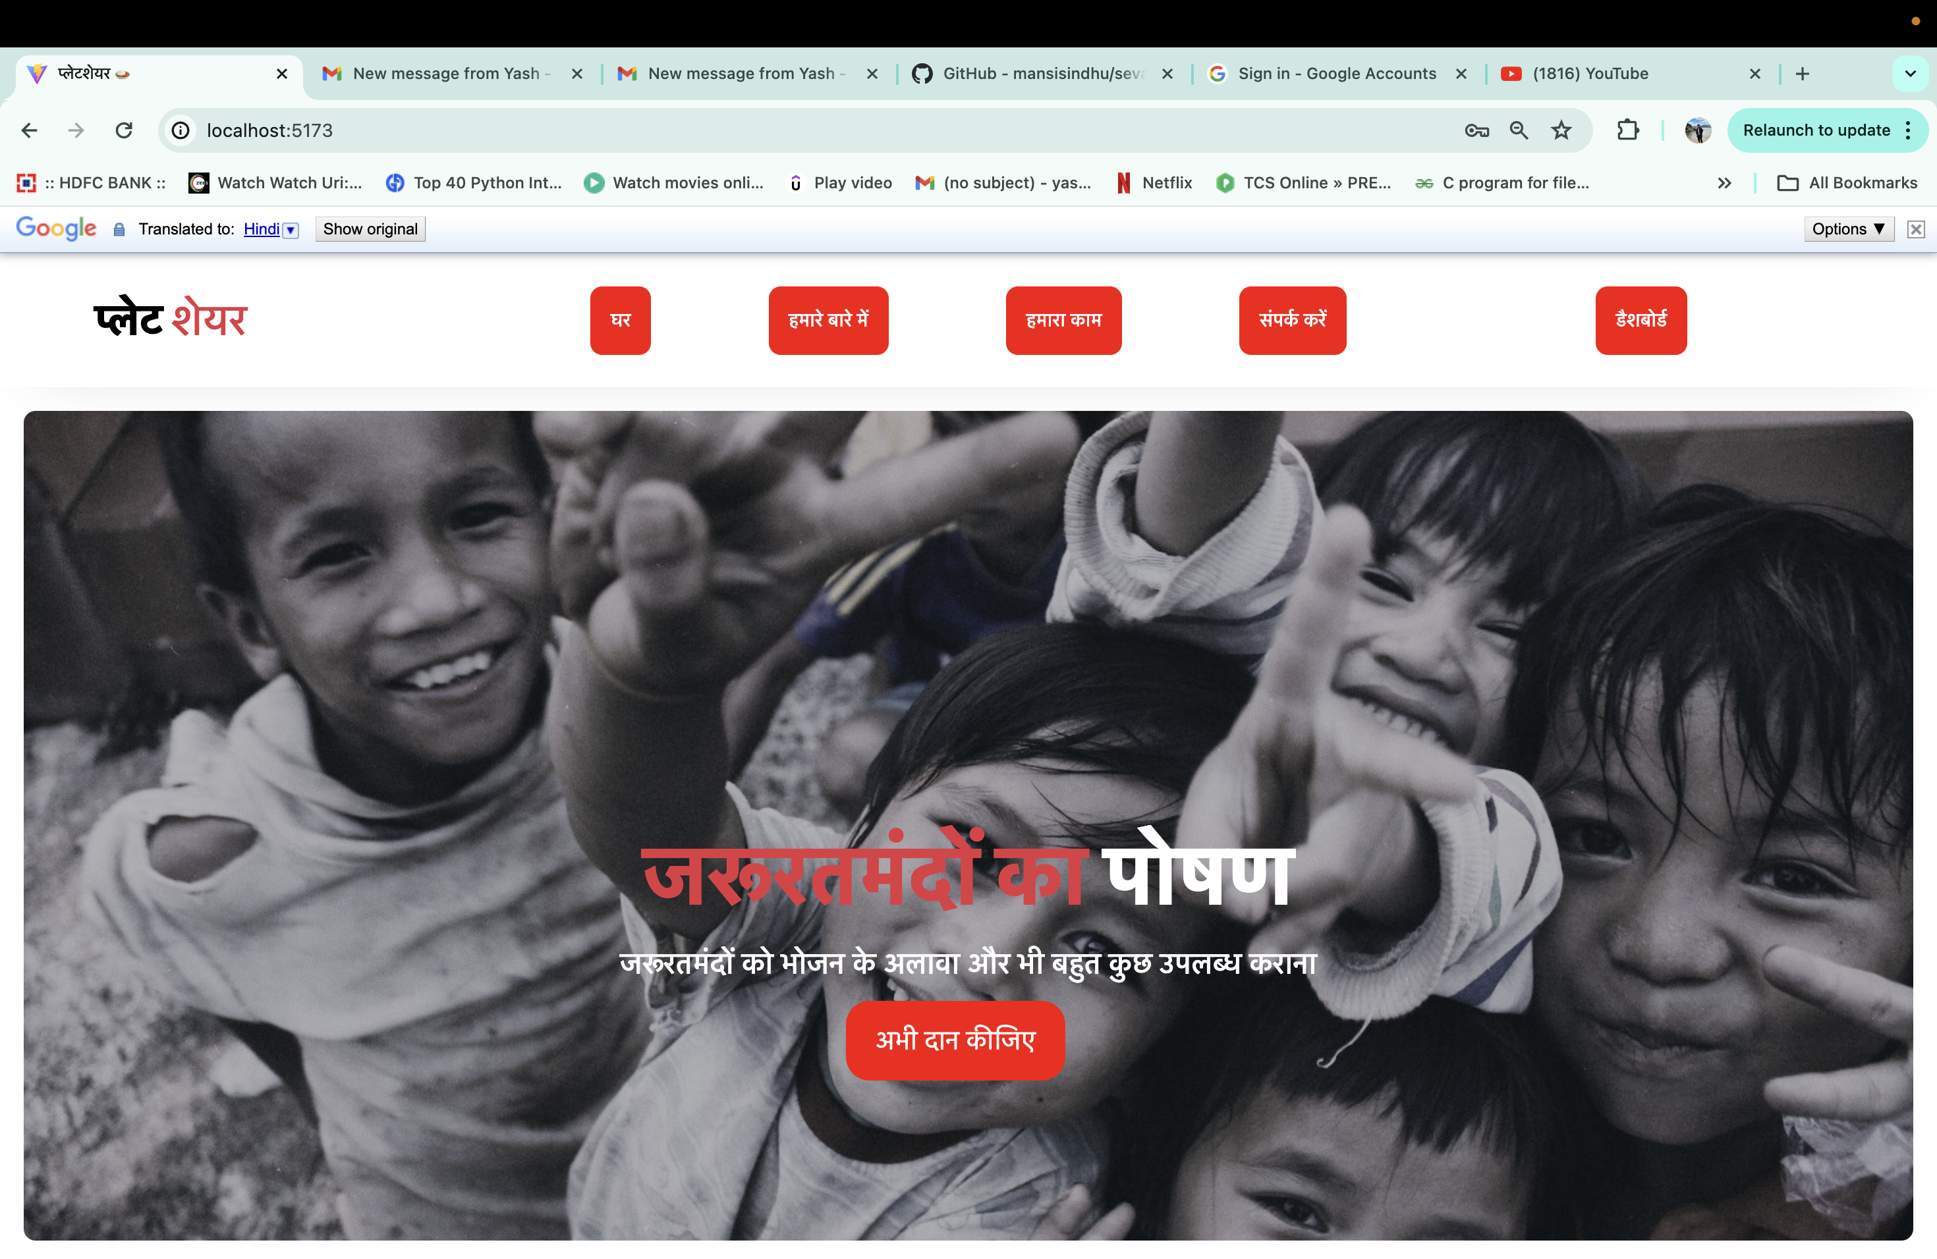
Internationalisation

